Slide 1

TUGAS BESAR DATA MINING
IF 3 B REGULER
Muhammad Faishal Nur Setiawan (3311901050)
Putri Viradima (3311901051)

Slide 2
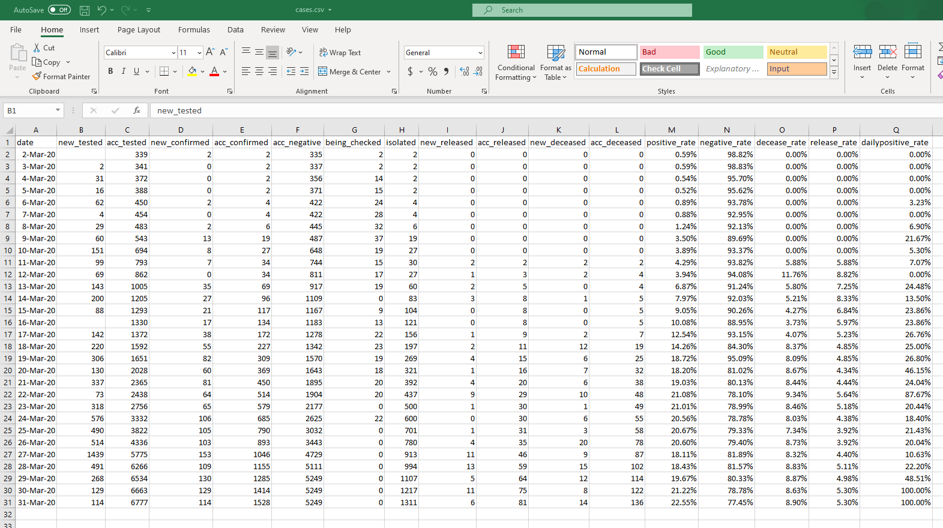
Dataset
https://www.kaggle.com/ardisragen/indonesia-coronavirus-cases

Slide 3

Judul Dataset
Indonesia-Coronavirus
Data Science for COVID-19 Indonesia (DSCI) Initiative
Context
COVID-19 has infected many people in Indonesia, and the number of confirmed cases is increasing exponentially. Indonesia has raised its coronavirus alert to the "Darurat Nasional (National Emergency)" until 29 May 2020. The Java island, especially Jakarta, the capital city of Indonesia, is the most affected region by the coronavirus.
Dataset yang digunakan
cases.csv
Dataset
https://www.kaggle.com/ardisragen/indonesia-coronavirus-cases

Slide 4
Dataset
Context
Following are the list of available online portals announce the information of COVID-19, from the public community and provincial (regional) government website in Indonesia.
https://www.covid19.go.id/situasi-virus-corona/, by Indonesian National Board for Disaster Management.
https://kawalcovid19.id/, by Kawal Covid-19 Indonesia community.
https://corona.jakarta.go.id/, Jakarta tanggap Covid-19 by Pemda DKI Jakarta.
https://pikobar.jabarprov.go.id/, Pusat Informasi & Koordinasi COVID-19, by Pemprov Jawa Barat.
https://corona.jatengprov.go.id/, Jawa Tengah Tanggap COVID-19, by Pemprov Jawa Tengah.
https://corona.sumbarprov.go.id/, Sumbar Tanggap Corona, by Pemprov Sumatera Barat.
http://corona.jogjaprov.go.id/, Yogyakarta Tanggap Covid-19, by Pemprov DIY.
https://covid19.bandung.go.id/. Pusat Informasi & Koordinasi COVID-19 Kota Bandung.
https://www.kaggle.com/ardisragen/indonesia-coronavirus-cases

Slide 5

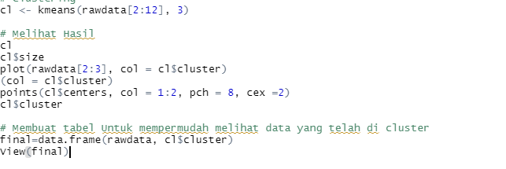

Proses Data Mining
Unduh dataset dari https://www.kaggle.com/ardisragen/indonesia-coronavirus-cases (disini kami mengambil dataset berkas cases.csv)
Mengatur lokasi kerja (kolom 2-4) dan mengimpor dataset (kolom 7-9).
Mengatasi missing value dengan mean (kolom 12-15).
Melakukan clustering menggunakan metode algoritma K-means dengan 3 titik cluster.
Menampilkan objek dalam bentuk gambar dan tambahkan point baru.

Slide 6
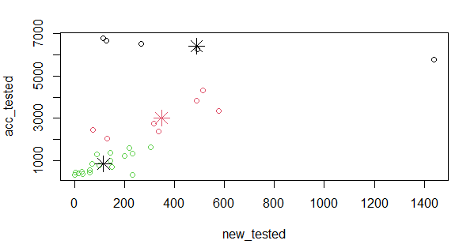

Hasil Data Mining
Terdapat 3 pembagian clustering.

Slide 7
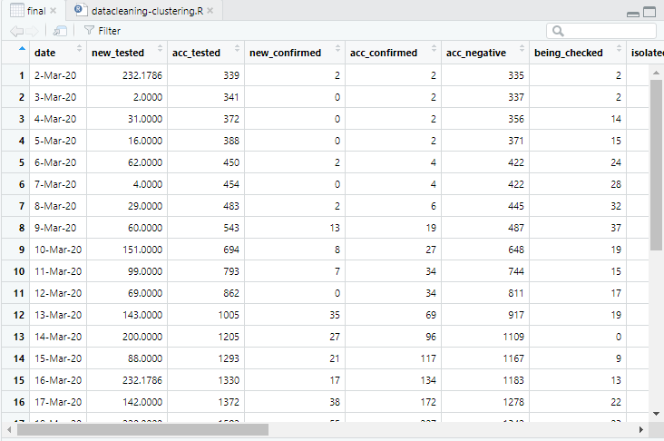
Hasil Data Mining
Nilai yang tidak lengkap telah terisi.
(new_tested row 1 & 15)

Slide 8

Referensi
Dataset:
https://www.kaggle.com/ardisragen/indonesia-coronavirus-cases
Link Github Assignment:
https://github.com/putriiv16/Tugas-Besar_Data-Mining_050-051
Link Github account:
https://github.com/HiddenSeat (M. Faishal Nur Setiawan)
https://github.com/putriiv16 (Putri Viradima)

